Slide 1
ROCHELLE PARK
BOARD OF EDUCATION
2022-2023 SCHOOL BUDGET
PUBLIC HEARING
APRIL 26, 2022 “Building and Sustaining a Community of Excellence”

Slide 2
“WE ENVISION AN EDUCATIONAL COMMUNITY WHICH INSPIRES AND EMPOWERS ALL STUDENTS TO BECOME SELF-SUFFICIENT AND THRIVE IN A COMPLEX, GLOBAL SOCIETY.”
MISSION STATEMENT

Slide 3
VISION STATEMENT
Establish and maintain a shared responsibility among home, school, and the greater community which fosters student learning, accountability, and citizenship.
To provide curricula that enables all students to meet or exceed current national, state, and local standards.
To utilize a variety of formative and summative assessments in order to differentiate and guide instruction.
The district, as a Professional Learning Community, will provide ongoing professional development training and opportunities for collaboration among faculty and staff.
Provide a safe and nurturing environment where all students have free access to academic and extra-curricular programs.

Slide 4
“AN INVESTMENT IN EDUCATION GIVES THE BEST RETURNS”- BENJAMIN FRANKLIN
The budget is a plan that balances the educational needs of the students with the fiscal needs of the taxpayers
The budget provides for all students in grades Pre-K through 12
The budget is developed by review of program needs and continued focus on instructional improvement
Student and Staff Safety
Efficiently managed Facilities

Slide 5
2022-2023 School Budget Information
There is no vote on the school budget if the General Fund Tax Levy is at or below the state cap of 2%.
The tentative 2022-2023 School Budget has been approved by the Bergen County Office of the NJ Department of Education and is being presented
this evening for public comment pending final approval by the Rochelle
Park Board of Education.

Slide 6
SHARED SERVICES
THE FOLLOWING SERVICES PROVIDE COST SAVINGS TO OUR DISTRICT:
Partner | Description
Rochelle Park Township | Police Department (LEAD program, Alert Systems), OEM, DPW, and Gasoline for BOE Vehicles, Library
South Bergen Jointure Commision (SBJC) | Collaboration among 17 districts for Professional Development, Curriculum Writing and Resources, and Special Education Related Services
SBJC | Student Transportation: General and Special Education
Ed Data, ECSNJ, HCESC, ACES | Co-Operative Purchasing for Supplies and Services
NESBIG | Property/Liability & Workers Compensation Insurance
Hackensack BOE | Send/Receive Relationship for Grades 9-12
Maywood BOE | Student Transportation

Slide 7
REVENUE
Category | 2022-23
Local Tax Levy | $ 13,313,494
Tuition From Individuals | $ 48,000
Budgeted Fund Balance | $ 250,000
Miscellaneous Revenue | $ 120,000
State Aid: Categorical | $ 832,213
State Aid: Extraordinary | $ 135,000
Withdrawal from Capital Reserve | $300,000
General Fund Total | $ 14,998,707

Slide 8
REVENUE CONTINUED
Category | 2022-23
Federal Aid (IDEA/ESSA) | $ 171,892
Debt Service (Local Taxes) | $ 307,612
Debt Service Aid | $ 158,466
Debt Service Total | $ 466,078
Grand Total | $ 15,636,677

Slide 9
STATE AID REVENUE
Category | 2021-22 | 2022-23 | Change
State Aid | $693,348 | $832,213 | $138,865
SDA Debt Assessment | $ (14,603) | $(14,603) | $ -
Net State Aid | $ 678,745 | $ 817,610 | $138,865

Slide 10
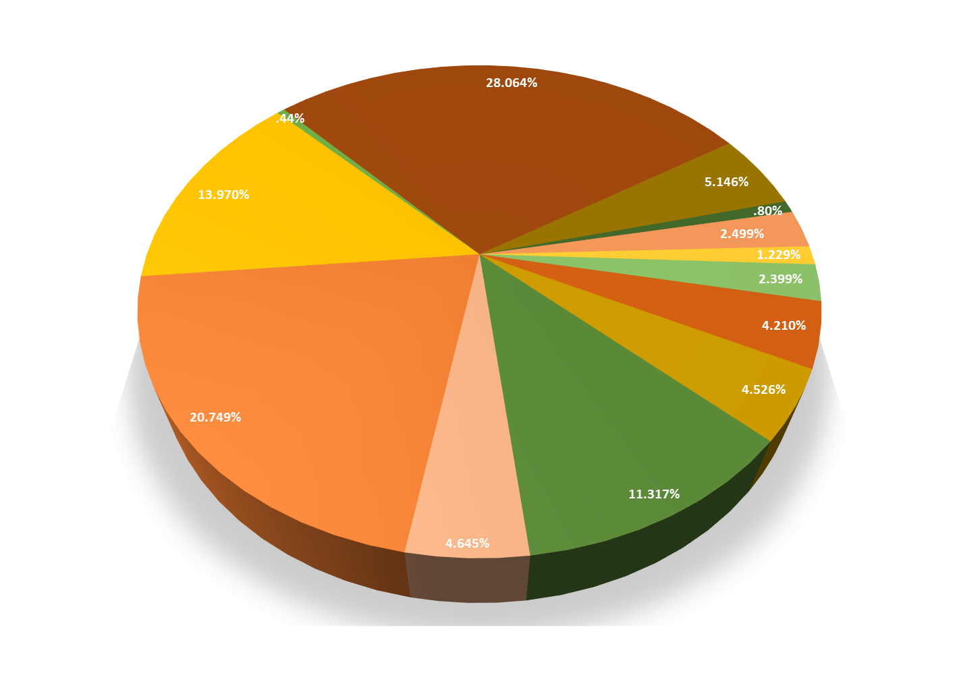
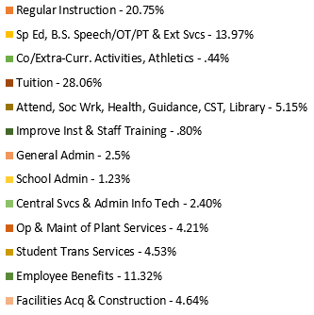
Appropriations

Slide 11
APPROPRIATIONS
Category | Budget Amount | Budget Percentage | Description
Regular Instruction | $3,112,142 | 20.75% | Teachers’ salaries, classroom supplies, instructional technology, and textbooks
Tuition | $4,209,301 | 28.06% | Hackensack High School, Bergen County Technical School District, and tuition for students in out-of-district placements
Special Education | $2,095,365 | 13.97% | Teacher salaries for special education, basic skills, ESL, aides, speech/OT/PT & extraordinary services.
Employee Benefits | $1,697,427 | 11.32% | Social security, medical and dental, pension contributions, workers’ comp insurance, unemployment, and tuition reimbursement
Administration | $919,075 | 6.13% | Salaries of Central Administration, School Administration, and Business Office and respective secretarial staff, legal, communication and technology, and other purchased professional services

Slide 12
APPROPRIATIONS CONTINUED
Category | Budget Amount | Budget Percentage | Description
Facilities | $631,481 | 4.21% | Salaries of custodial staff, contracted services for building maintenance, energy, water, property insurance, custodial and maintenance supplies
Improvement of Instruction | $120,583 | .80% | Curriculum and staff development
Facilities Construction | $696,649 | 4.64% | Enhancement to outdoor facilities and SDA debt assessment
Co-Curricular/Athletics | $66,030 | .44% | Extra curricular activities and sports

Slide 13
APPROPRIATIONS CONTINUED
Category | Budget Amount | Budget Percentage | Description
Transportation | $ 678,846 | 4.53% | Transportation for students attending Hackensack High School, Bergen County Technical School District, Out of District students, sports, and co-curricular events
Support Services | $771,808 | 5.15% | Child Study Team, Health, Guidance, Attendance, and Media Center
Total Operating Budget | $14,998,707 | 100% | The local tax levy supports 89% of the proposed 2022-23 total operating budget

Slide 14
APPROPRIATIONS CONTINUED
Category | Budget Amount | Description
IDEA/ESSA (Federal Aid) | $ 171,892 | IDEA funds are used for several out of district tuitions and ESSA funds are used to supplement school services
Debt Service Payments | $466,078 | 22-23 principle and interest of outstanding debt
Total Budget | $15,636,677 | Total 2022-2023 budget

Slide 15
HIGHLIGHTS OF THE 2022-23 BUDGET
World Language Teacher, 1 full-time position
Wellness Coordinator
2 New Middle School Courses: Financial Literacy and Career Explorations
Expanding Literacy Program: Readers & Writers Workshop
Pre-K Class: continued 2 sections, non-compulsory & eliminating lottery
Curriculum: NJSLS alignment as mandated & district option for ELA and Math
STEAM Room
Updating Nurse’s Office
Outside Facility: Repairs and updates to grounds
Indoor Air Quality, maintaining healthy upgrades & air conditioning
Co-curricular services
Summer programs and Extended School Day
Technology: sustaining changes for hardware, software & e-platforms

Slide 16
Referendum Impact on the
2022-2023 School Budget
On December 10, 2013, the local taxpayers of Rochelle Park approved the proposed $6,513,000 referendum
Due to the decrease in the bond payment the referendum project will have no impact on a tax payment during 2022-2023.

Slide 17
TAX IMPACT - General Budget
To support the New Jersey Student Learning Standards
To calculate the tax rate, divide the amount to be raised by taxes by the total Assessed Valuation |  | Amount to be Raised |  | Assessed Valuation
Fiscal Year 2022-2023 |  | 13,313,494 |  | 959,972,500
How much will my taxes increase? Average Residential Value |  | 333,699 |  | Tax Increase $242.00
On the Average Assessed Home $333,699
This increase equals $20.16 per month

Slide 18
ELECTION INFORMATION
2012 law gave the option of moving school elections from April to the General Election in November.
Rochelle Park Board of Education opted to move the school elections to November.
School Board candidates are now included on November ballot for General Election.
The vote on school budgets at or below the Tax Levy Cap is eliminated.
The 2022-2023 school budget is within the Tax Levy Cap.

Slide 19
As always, the Rochelle Park Board of Education and administration are committed to developing a school budget that provides for a 21st century education within the tax levy cap of 2%. Our efforts represent our commitment to be fiscally responsible to our taxpayers while meeting or exceeding the New Jersey Student Learning Standards (NJSLS) so that our students succeed and thrive as lifelong learners.
For additional information, please feel free to contact
Dr. Sue DeNobile, Superintendent, at (201) 843-3120 ext. 514 or
Mrs. Cheryl Jiosi, Business Administrator, at (201) 843-3120 ext. 513
Please visit our website http://rochellepark.org for more updates and information

Slide 20
THANK YOU
Superintendent: Dr. Sue DeNobile
Business Administrator: Cheryl Jiosi
Board President: Matthew Trawinski
Board Vice-President: Scott Kral
Board Members:
Adib Abboud
Teresa Judge Cravello
Joseph Marolda
Jorge Martinez Jr.
Charles Schaadt

